Slide 1
WATER QUALITY PREDICTION
presented by trainer
AVINASH REDDY MULA RAMESH.D
2203A52227 asst.prof(cse-ai&ml)

Slide 2
content
PROBLEM STATEMENT
INTRODUCTION
DATASET
IMPLEMENTATION
RESULT & COMPARISION
CONCLUSION

Slide 3

PROBLEM STATEMENT
Develop a model that can accurately predict the potability of water based on various water quality parameters such as pH, hardness, solids, chloramines, and more. The model should be able to classify water samples as potable or non-potable with high accuracy to help ensure safe drinking water for communities.

Slide 4
Introduction
Water potability refers to the quality of water that determines its suitability for consumption and everyday use without causing harm to human health access to safe and potable water is a fundamental human right and a crucial component of public health. In this context,potable water is a water means water that is free from contaminants,pollutants,and pathogens that could pose risks to those who consume it.

Slide 5
DATASET
Proposed system is implemented using the water potability dataset from Kaggle.The water_potability.csv file contains water quality metrics for 3276 dataset,9 features and one class variable.
Feature lists are pH, Hardness, Solids, Chloromines. Sulfates, conductivity, Organic carbon, Trihalomethanes, Turbidity
https://www.kaggle.com/datasets/adityakadiwal/water-potability

Slide 6
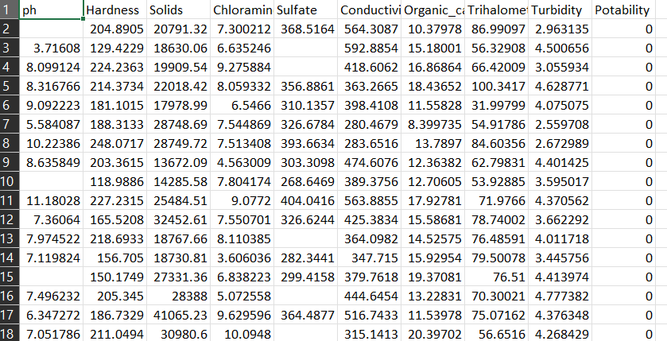
DATASET

Slide 7
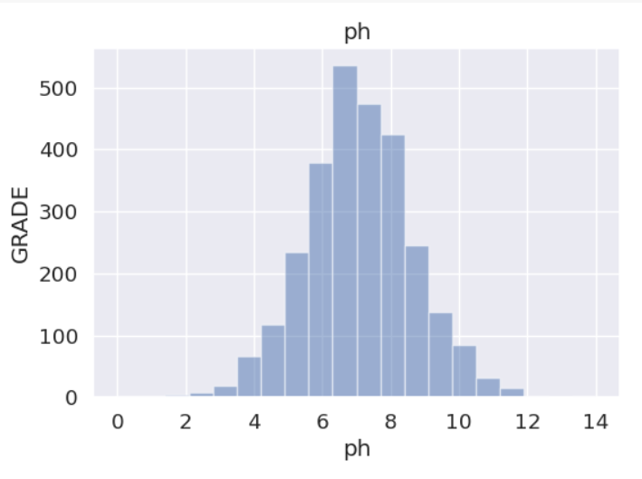
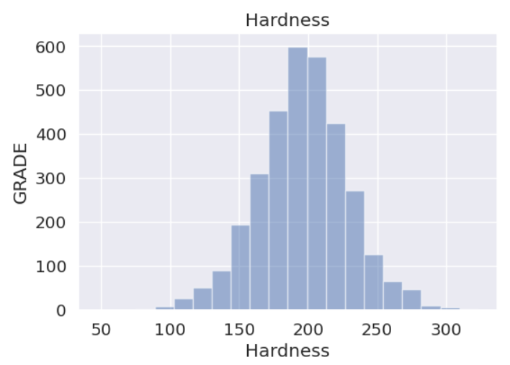
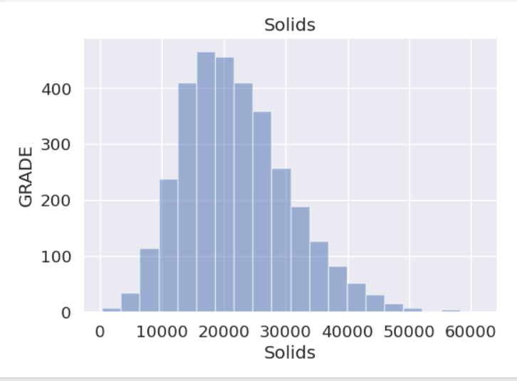
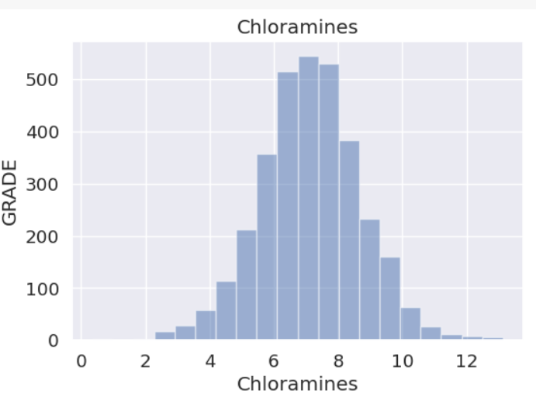
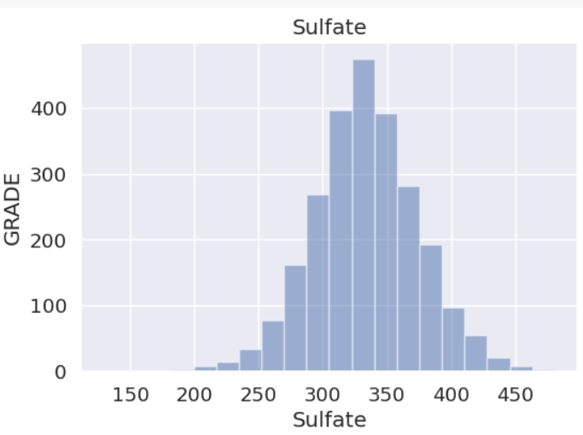
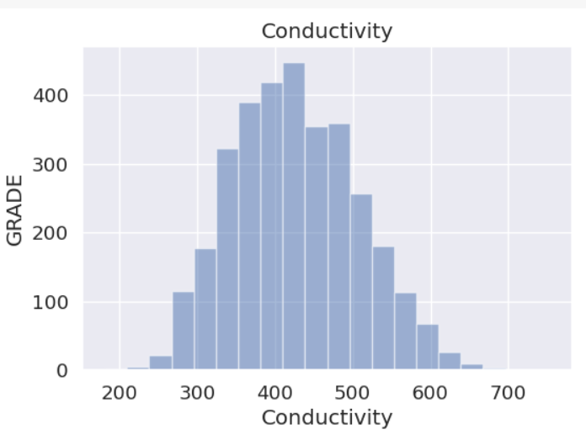
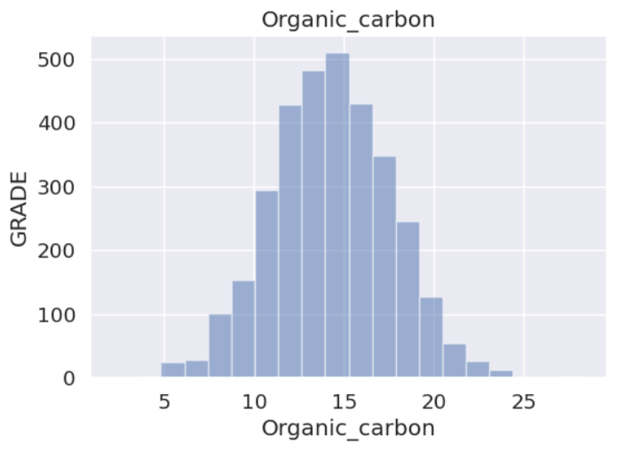
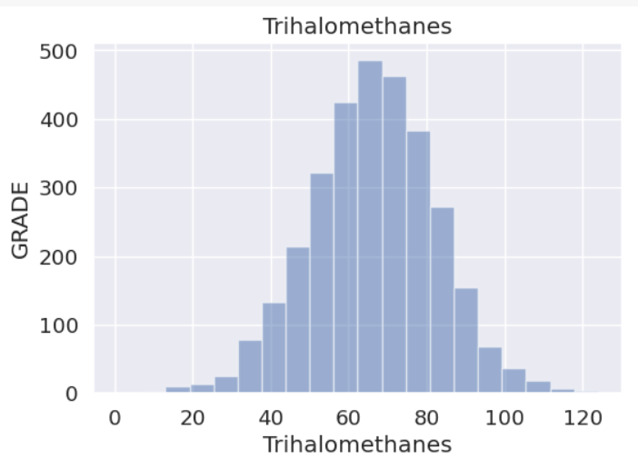
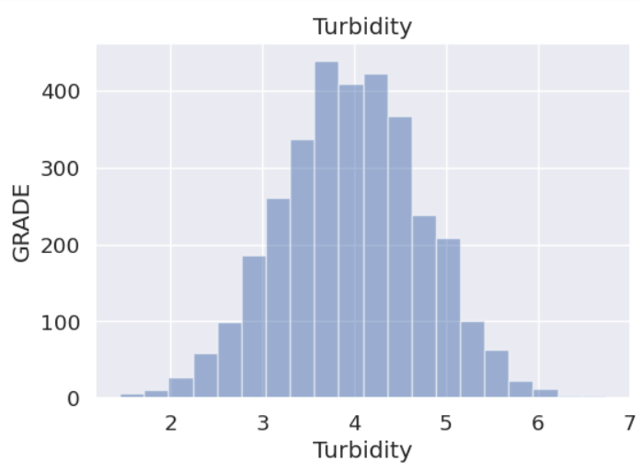
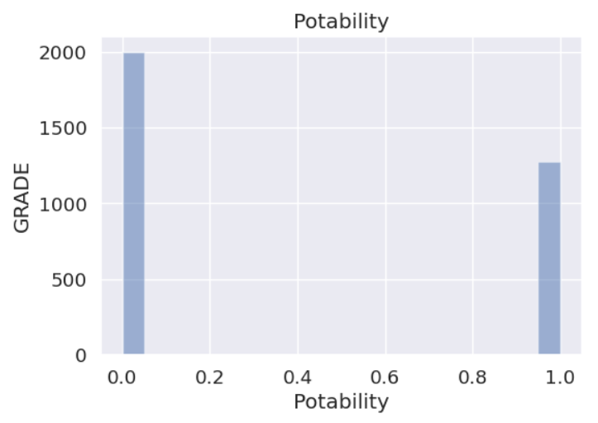
Data visualization
Histogram representation of all the feature list and the class variable:

Slide 8
Implementation
Perceptron:
A perceptron is a fundamental building block of artificial neural networks and serves as a simple model of a biological neuron. It was developed by Frank Rosenblatt in the late 1950s. A perceptron takes a set of binary inputs and produces a binary output based on a weighted sum of these inputs. It can be used for binary classification tasks where it learns to separate data points into two categories.
Here's an explanation of the perceptron with its formula:
Inputs: A perceptron takes multiple binary input values, denoted as x₁, x₂, x₃, ..., xᵢ. These inputs can be either 0 or 1.
Weights: Each input is associated with a weight, denoted as w₁, w₂, w₃, ..., wᵢ. These weights are real numbers and represent the strength of the connection between the input and the perceptron.
Weighted Sum: The weighted sum of the inputs is calculated as follows:
Weighted Sum (Z) = w₁ * x₁ + w₂ * x₂ + w₃ * x₃ + ... + wᵢ * xᵢ
network architectures.

Slide 9
LOGISTIC REGRESSION
Logistic regression is a statistical model used for binary classification tasks, where the goal is to predict one of two possible outcomes (e.g., 0 or 1, Yes or No, True or False) based on one or more input features
Unlike linear regression, which predicts a continuous output, logistic regression predicts the probability of the binary outcome. It uses the logistic function (also called the sigmoid function) to model this probability.
Here's an explanation of logistic regression with its formula:
Formula: The logistic regression model calculates the probability (P) of a binary event (e.g., the probability of a positive outcome) using the logistic function:
z=w0+w1x1+w2x2----------------wnxn
yp=1/1+e^-z​
z=-Y LOG (YP)-(1-Y) LOG (1-YP)

Slide 10
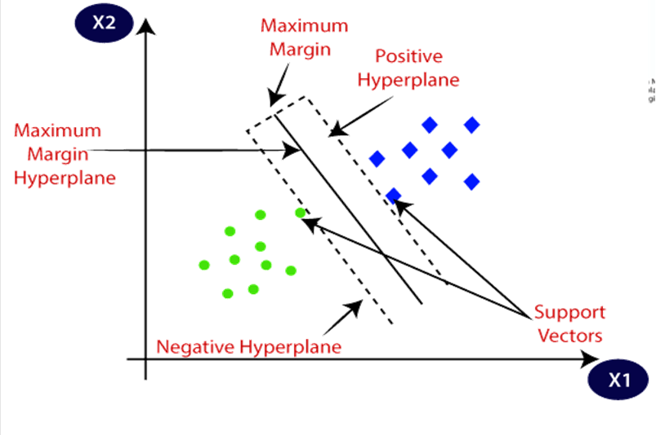
SUPPORT VECTOR MACHINE ALGORITHM
Support Vector Machine or SVM is one of the most popular Supervised Learning algorithms, which is used for Classification as well as Regression problems. However, primarily, it is used for Classification problems in Machine Learning.
The goal of the SVM algorithm is to create the best line or decision boundary that can segregate n-dimensional space into classes so that we can easily put the new data point in the correct category in the future. This best decision boundary is called a hyperplane.

Slide 11
K-NEAREST NEIGHBOURS(K-NN)
K-Nearest Neighbors (K-NN) is a simple and effective machine learning algorithm used for both classification and regression tasks. It operates on the principle that similar data points are located near each other in a feature space. Here's how it works:
1.Training: K-NN doesn't have a traditional training phase. Instead, it memorizes the entire dataset, creating a reference for future predictions.
2. Prediction: To classify a new data point, K-NN calculates the distance (typically Euclidean distance) between the point and its K nearest neighbors in the training dataset.
3. Voting: For classification, it counts the number of data points in each class among the K neighbors. The class with the highest count becomes the predicted class. For regression, it averages the values of the K nearest neighbors.

Slide 12
4. Choosing K:The choice of K is a critical hyperparameter. A smaller K makes the model sensitive to noise, while a larger K might over smooth the decision boundaries.
K-NN is simple to understand and implement, but its performance depends heavily on the choice of K, the distance metric, and the quality of the training data. It's a non-parametric and instance-based algorithm, making it robust to changes in the data distribution. However, it can be computationally expensive for large datasets since it requires calculating distances to all data points during prediction.

Slide 13
BOOT STRAPPING
Bootstrapping is a resampling technique widely used in statistics and machine learning to estimate the sampling distribution of a statistic, construct confidence intervals, and make robust predictions. The key idea behind bootstrapping is to create multiple resamples (bootstrap samples) from a single dataset, allowing for statistical inference without making strong parametric assumptions.
Here's how bootstrapping works:
1. Resampling: Given a dataset with n observations, bootstrapping involves randomly drawing n samples with replacement from the original dataset to create a bootstrap sample. This process is repeated to generate a large number of bootstrap samples (typically thousands).

Slide 14
2. Estimation: With the obtained bootstrap samples, you can compute statistics of interest, such as means, medians, variances, and confidence intervals. These statistics represent estimates of the population parameters based on the observed data.
3. Inference: Bootstrapping provides a way to quantify the uncertainty associated with your estimates. It allows you to construct confidence intervals by assessing the distribution of the statistic across the bootstrap samples.
Bootstrapping is particularly valuable when dealing with small sample sizes or when the underlying data distribution is unknown or complex. It doesn't assume specific parametric models, making it a versatile tool for a wide range of statistical analyses. It also helps to identify outliers, assess model stability, and improve the reliability of machine learning algorithms by estimating prediction error more accurately. However, it can be computationally intensive when a large number of bootstrap samples are required for robust results.

Slide 15
PRINCIPAL COMPONENT
Principal Component Analysis (PCA) is a dimensionality reduction technique used in data analysis and machine learning to simplify complex datasets while preserving essential information. It identifies and extracts the most influential patterns, reducing data dimensions and aiding visualization, noise reduction, and improved model performance.
Here's how PCA works:
1. Data Transformation: PCA takes a dataset with multiple correlated features and transforms it into a new coordinate system, represented by orthogonal axes called principal components. The first principal component (PC1) explains the most variance in the data, the second (PC2) explains the second most, and so on.

Slide 16
2. Variance Maximization: PCA calculates these principal components such that PC1 explains the maximum variance, PC2 explains the maximum remaining variance orthogonal to PC1, and so on. This helps to capture the most critical information in the data.
3. Dimension Reduction: Researchers often retain a subset of the top principal components, reducing the dataset's dimensionality while retaining a significant portion of the original data's variance. This simplifies subsequent analysis.
4. Visualization and Compression: PCA can help visualize high-dimensional data in a lower-dimensional space. It's also used for data compression, as it retains most of the relevant information with fewer features.

Slide 17
RESULT
S.NO | MODEL | ACCURACY
1 | PERCEPTRON | 37%
2 | LOGISTIC REGRESSION | 0.63
3 | SVM | 0.57
4 | KNN | 0.58

Slide 18
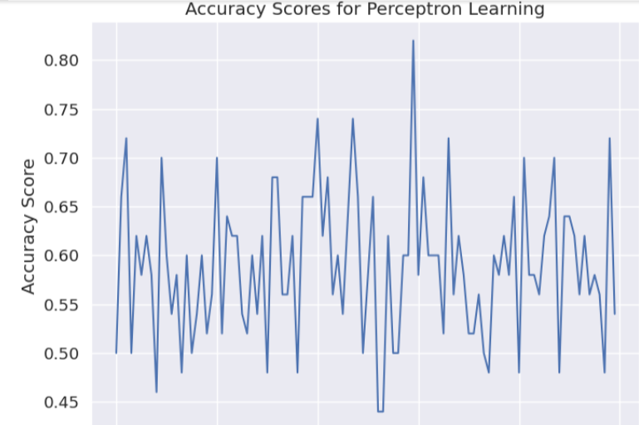
Boot Strapping for perceptron:

Slide 19
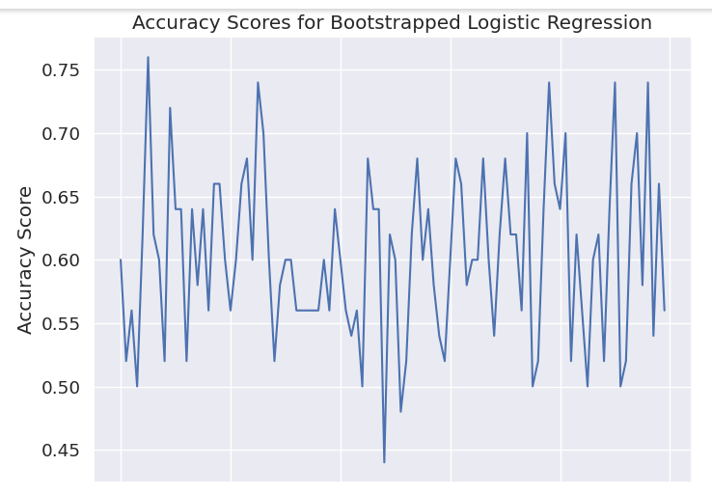
Boot Strapping for Logistic regression:

Slide 20
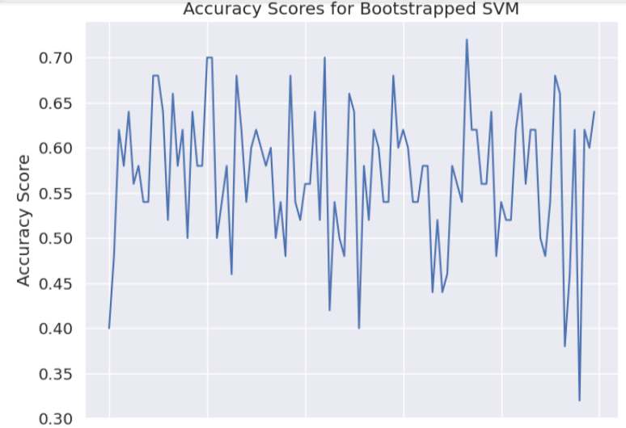
Boot Strapping for SVM:

Slide 21
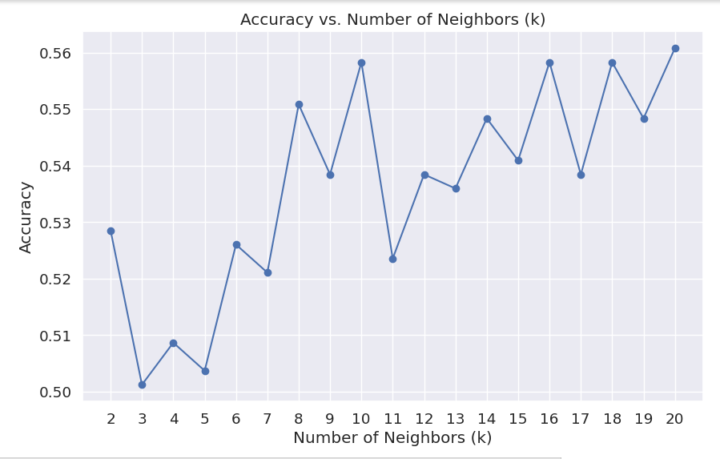
Boot Strapping for KNN:

Slide 22
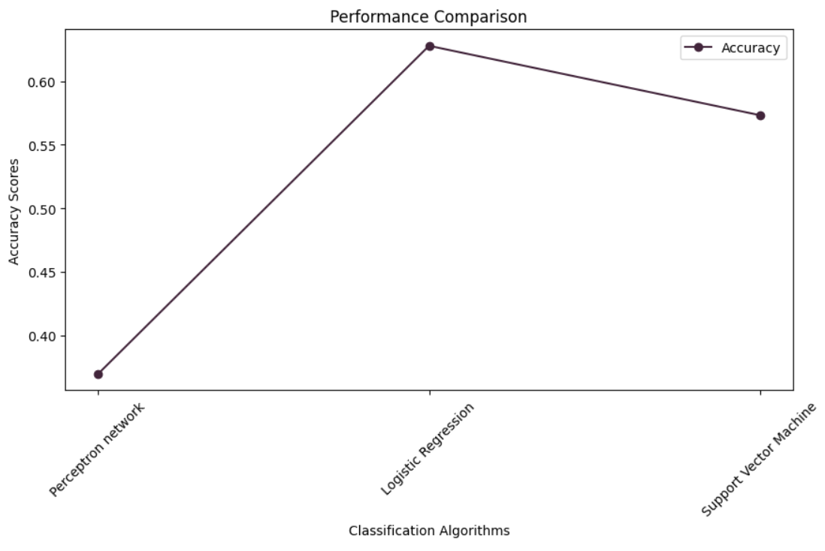
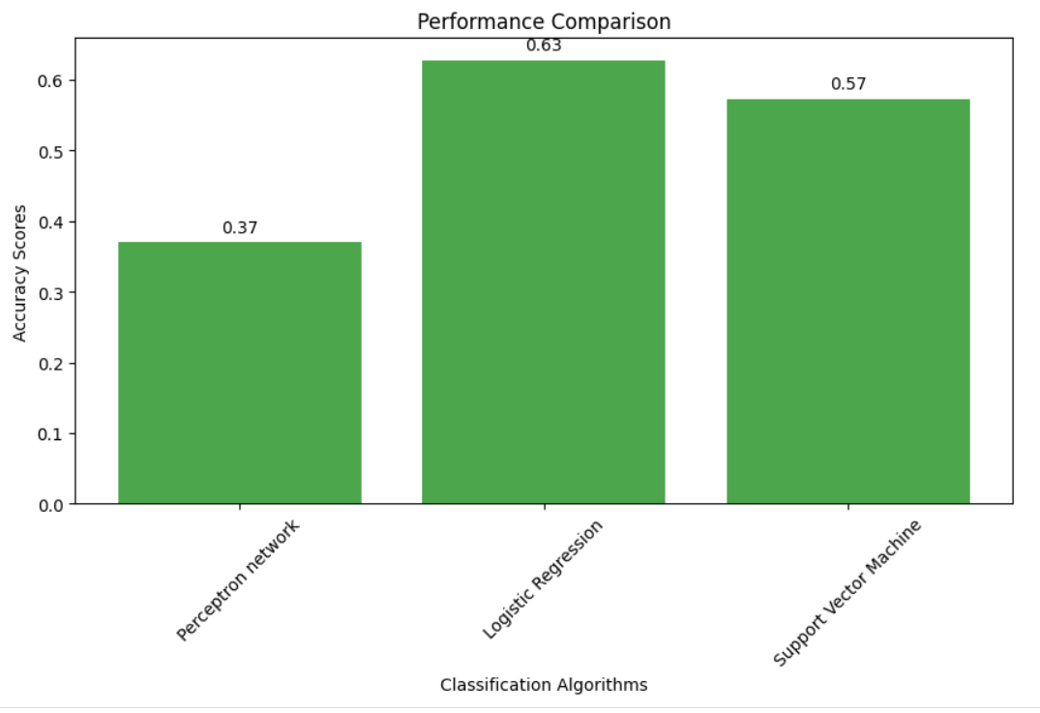
Accuracy is a common evaluation metric used in machine learning and statistics to measure the overall correctness of a model's predictions in a classification task. It quantifies the ratio of correctly predicted instances to the total number of instances in the dataset.​​
Accuracy by using graph Accuracy by using Bar-graph

Slide 23
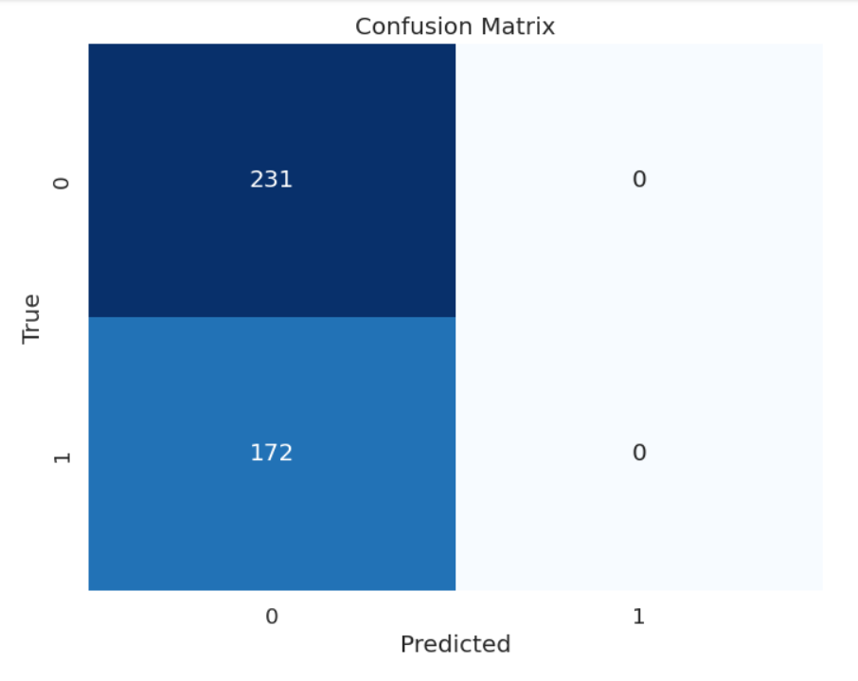
CONFUSION MATRIX
A confusion matrix is a tool used in the field of machine learning and statistics to evaluate the performance of a classification algorithm, particularly in binary or multiclass classification problems. It provides a tabular representation of the actual and predicted classifications made by the algorithm.​

Slide 24
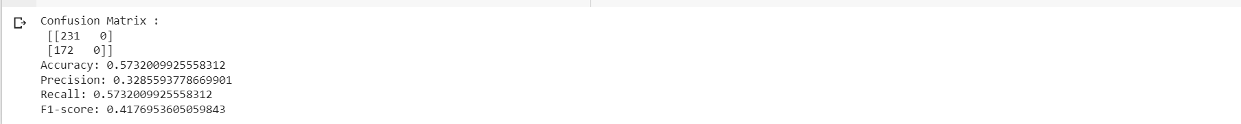

Slide 25
CONCLUSION
Addressing the problem of water potability is of utmost importance to protect public health and promote human development. This comprehensive problem statement outlines the multifaceted challenges and objectives associated with assessing and ensuring the potability of drinking water sources, underscoring the need for interdisciplinary collaboration and concerted efforts by governments, organizations, and communities to secure safe drinking water for all.

Slide 26
GITHUB LINK:
I done the total project by using google Collaboratory. The link of the improvement of the data set using parametric methods is given below:
https://github.com/MULAAVINASHREDDY/WATER-POTABILITY-REVIEW.2-2203A52227.ipynb.git

Slide 27
Thank you !

